Slide 1




.NET Architects Day 2010
Patrocinadores:

Slide 2
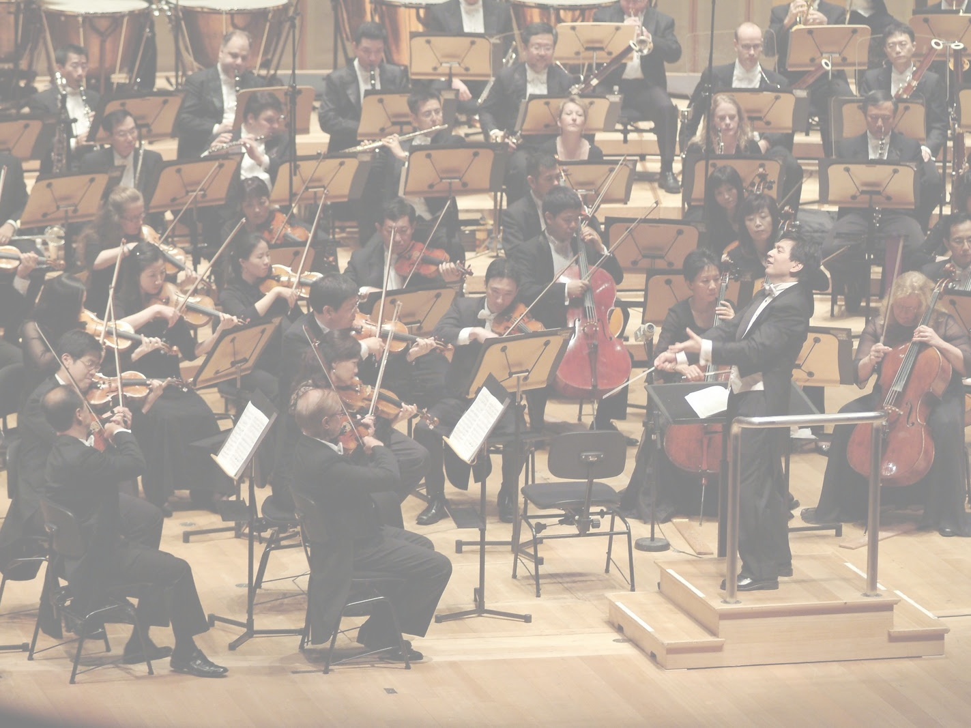

Integração Contínua
Muito Além do Build

Slide 3

Juan Lopes
Humano Programador
@juanplopes
github.com/juanplopes

Slide 4


Slide 5


Slide 6

Muitas Ferramentas
Notes:
PERGUNTAR

Slide 7
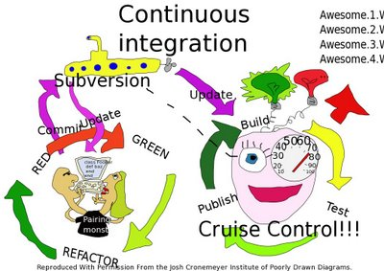

Slide 8

Unidade de Trabalho

Slide 9

Mainline

Slide 10
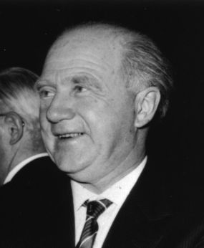
Werner Heisenberg

Slide 11

Operações Atômicas

Slide 12

Checkout Exclusivo
Notes:
PERGUNTAR

Slide 13
“
Continuous Integration is a software development practice where members of a team integrate their work frequently, usually each person integrates at least daily - leading to multiple integrations per day. Each integration is verified by an automated build (including test) to detect integration errors as quickly as possible.
Martin Fowler
(http://www.martinfowler.com/articles/continuousIntegration.html)

Slide 14




Version Control
Notes:
Falar do cliente

Slide 15

Seja um Escoteiro

Slide 16
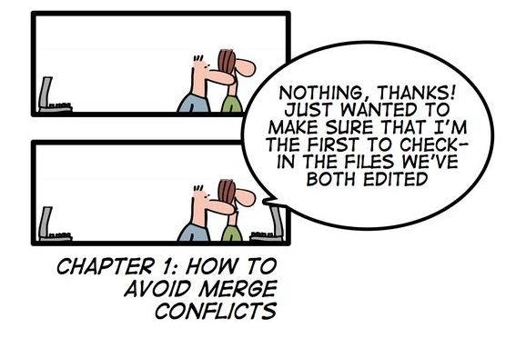

Slide 17

Build Automatizado
Notes:
NÃO É SERVIDOR AUTOMATIZADO

Slide 18
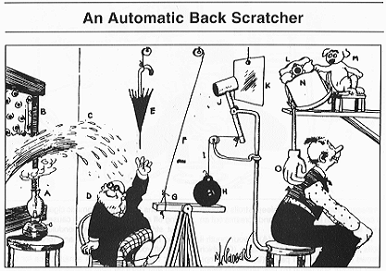

Slide 19
msbuildtasks.tigris.org
albacorebuild.net

Slide 20
“
Compilou,
0 errors, 0 warnings,
tá tudo ok.
Lincoln Júnior
Notes:
PERGUNTAR

Slide 21

“
I find your lack of tests disturbing.
Sebastian Bergmann

Slide 22

Testando o sistema antes
de mandar para o cliente

Slide 23

Sandbox
Notes:
AVANÇAR PRÓXIMO COM PIADA

Slide 24

Litter Box
Notes:
PERGUNTAR (QUANTOS OBRIGADOS)

Slide 25
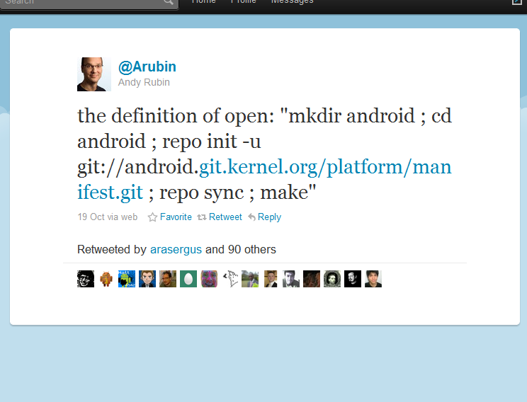

Slide 26
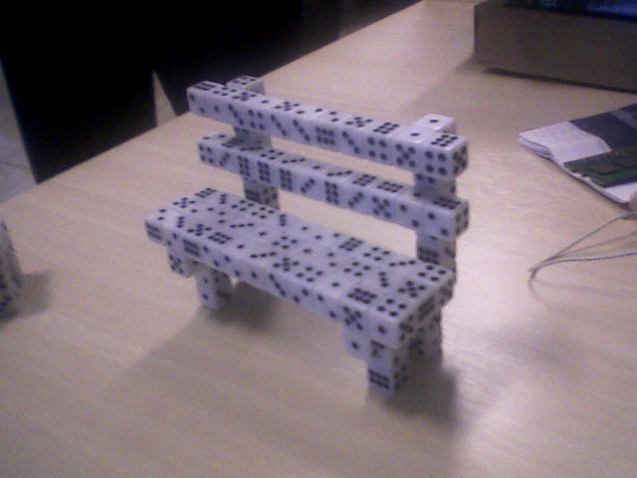
Banco de Dados

Slide 27

Backup/Restore

Slide 28

Migrations

Slide 29
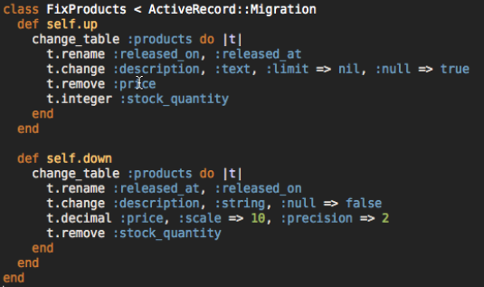
Rails Migrations

Slide 30
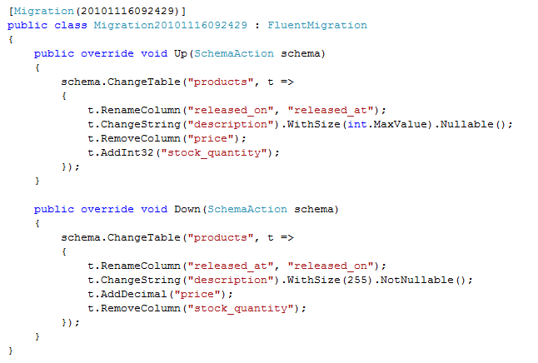
.Net Migrations

Slide 31

Integração Machine-friendly
Ok, não tão
friendly.

Slide 32
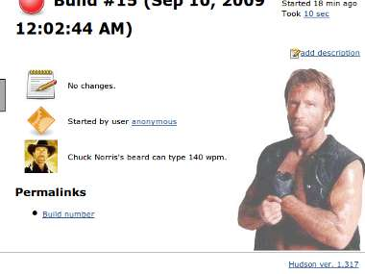
Ai sim, um servidor.

Slide 33
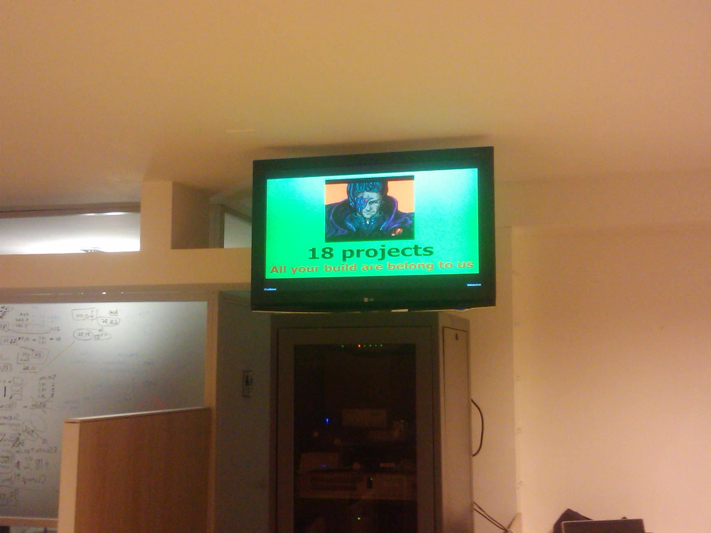
Radiators! :-D

Slide 34
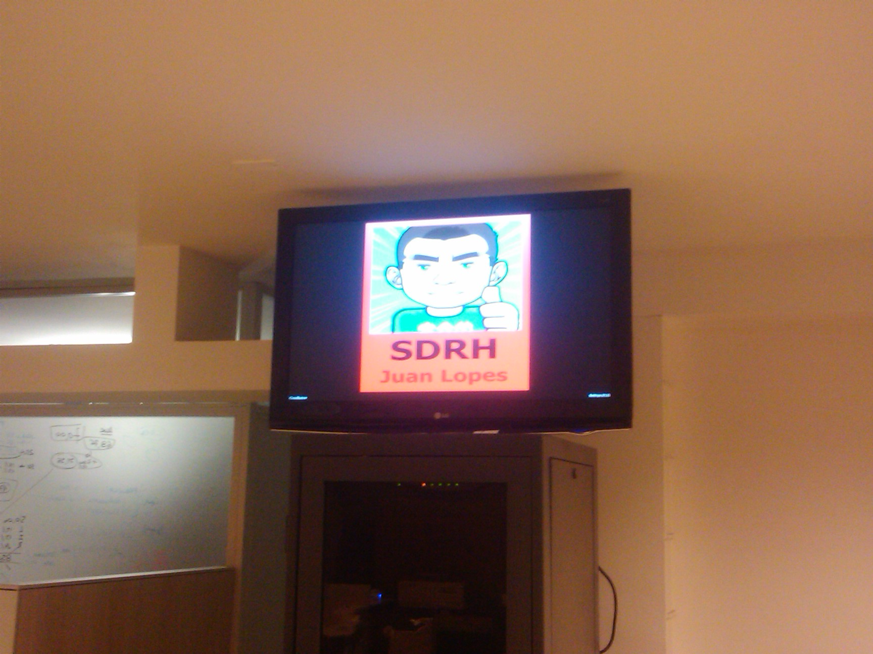
Radiators! :-(

Slide 35

Nightly Builds

Slide 36
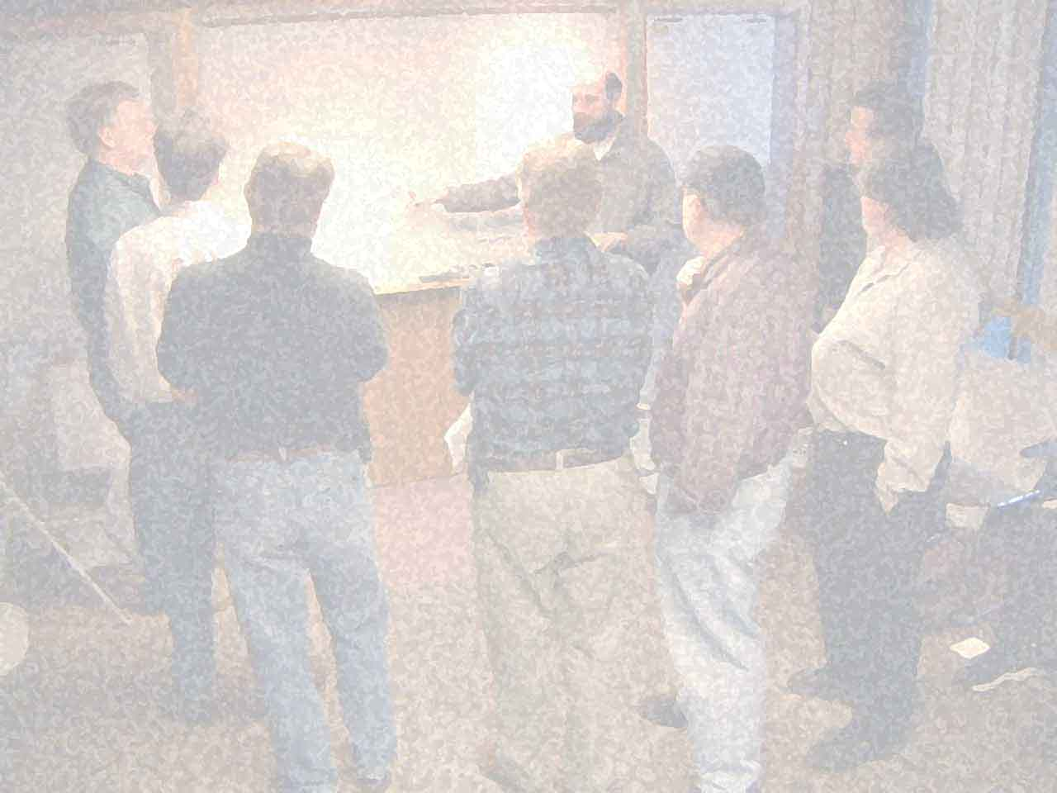
Notes:
PERGUNTAR SOBRE OS PRINCÍPIOS

Slide 37
Principles behind the Agile Manifesto
(...)
Deliver working software frequently, from a
couple of weeks to a couple of months, with a
preference to the shorter timescale.
(...)

Slide 38
couple of days

Slide 39
couple of hours!

Slide 40
“
Release Early. Release Often.
And listen to your customers.
Eric S. Raymond (who credits Linus Torvalds)

Slide 41

github.com/juanplopes/ci-alem-do-build
Obrigado!

